Slide 1
Project Portfolio Process
A project may be managed in three separate scenarios: as a stand-alone project (outside of a portfolio or program), within a program, or within a portfolio.
Project managers interact with portfolio and program managers when a project is within a program or portfolio.
For example, multiple projects may be needed to accomplish a set of goals and objectives for an organization. In those situations, projects may be grouped together into a program.
A program is defined as a group of related projects, subsidiary programs, and program activities managed in a coordinated manner to obtain benefits not available from managing them individually

Slide 2
Project Portfolio Process
A portfolio is defined as projects, programs, subsidiary portfolios, and operations managed as a group to achieve strategic objectives.
Portfolio management is defined as the centralized management of one or more portfolios to achieve strategic objectives. The programs or projects of the portfolio may not necessarily be interdependent or directly related.
Attempts to link project to goals and strategy of organisation
Occurs throughout lifecycle of project
PPP also meant for monitoring and controlling strategic projects
Shutting down projects before completion because their risks have become excessive, their costs have escalated out of line with their expected benefits, another (or a new) project does a better job of supporting the goals

Slide 4
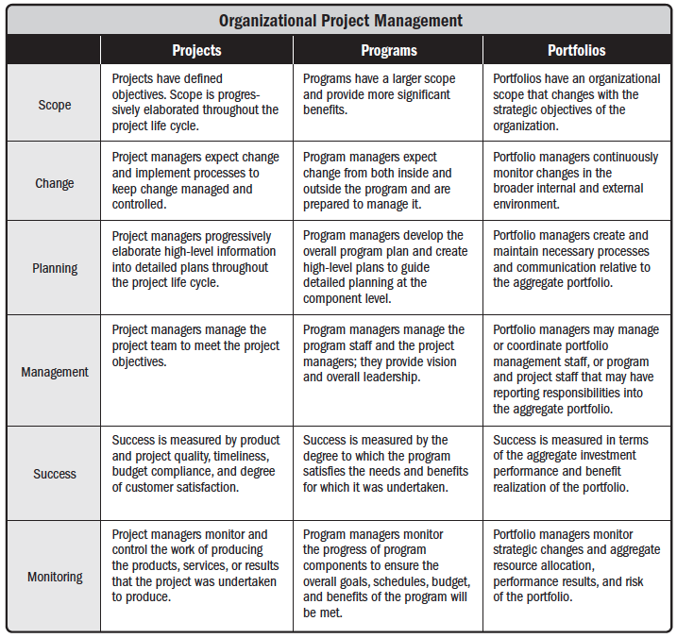

Slide 5
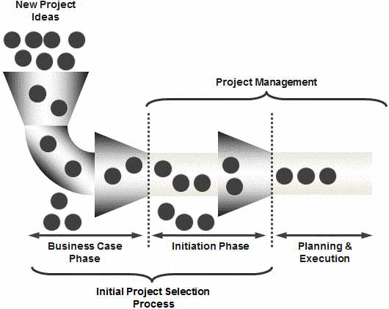

Slide 6
Project Portfolio Process (PPP)
Step 1: Establish a Project Council
Step 2: Identify Project Categories & Criteria
Step 3: Collect Project Data
Step 4: Assess Resource Availability
Step 5: Reduce Project and Criteria Set
Step 6: Prioritize Projects within Categories
Step 7: Select the Projects to be funded and held reserve
Step 8: Implement the Process

Slide 7
1. Establish a Project Council
To establish and articulate strategic direction of projects
Also responsible for allocating funds, resources and skills
Council
Senior Managers
the project managers of major projects;
the head of the Project Management Office, if one exists;
particularly relevant general managers;
those who can identify key opportunities and risks facing the organization; and
anyone who can derail the progress of the PPP later on in the process.

Slide 8
2. Identify Project Categories & Criteria
Various projects categories are identified
So that it will be spread appropriately to meet various goals of the organisation
Discriminate between good and better projects
Criteria's are weighted to reflect their relative importance
First step is to list goals of each existing and proposed project

Slide 9
Aggregate Project Plan
Categories proposed by Weelwright and Clark
Derivative Projects
Platform Projects
Breakthrough Projects
R&D Projects

Slide 10
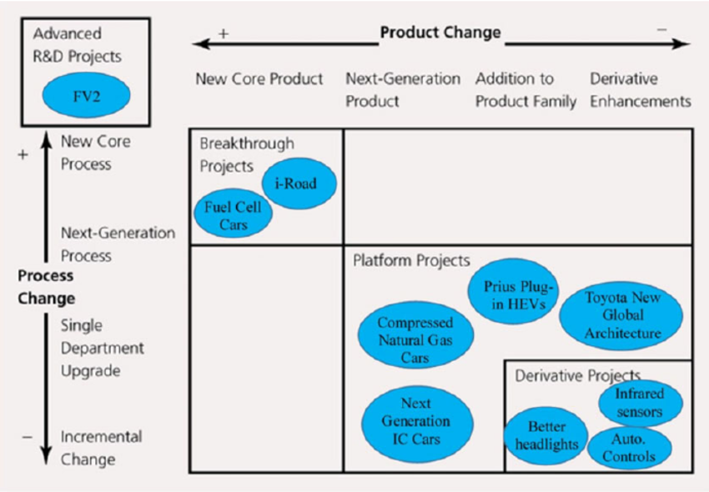
Aggregate Project Plan

Slide 12
Aggregate project plan can be used to
Views the mix of projects within each category
Analyse and adjust mix of projects within each category
Assess the resource demands
Identify and adjust the gaps in categories, sizes and timing of projects
To identify workforce requirement

Slide 13
3. Collect Project Data
For existing and proposed project collect data appropriate to the category criteria
Timing, date, duration, expected benefits and resource needed
Use project plan, schedule of project activities, past experience, expert opinion to get good estimate of the data
Identify any projects that can be deferred to a later time period, those that must precede or follow other projects, those that support other projects or should be done in conjunction with them, those that can be outsourced, and other such special aspects of the projects.
Use criteria score limits to screen out the weaker projects
Escalating costs
Changed organisational goals
Changed regulations or law

Slide 14
4. Assess Resource Availability
Assess the availability of both internal and external resources by type, department and timing.
Council will be trying to balance aggregate project resource needs over future periods with resource availabilities

Slide 15
5. Reduce the Project and Criteria Set
Whether the project support organisational goals
Whether required competence exits in the organisation
Profitability
Risk
Resources
If the projects has slipped from its objectives
If the project dominated by another existing or proposed project

Slide 16
6. Prioritise the Projects within Categories
Apply score and criterion weights to rank projects
Reconsider the projects in terms of their benefits first and their resource costs second.
Council summarizes return from the project to the organization by category.

Slide 17
7. Select the Projects to be funded and held reserve
Determine the mix of projects across various categories
Leave 20-25 % of the organisations resources for new opportunities, crisis in existing project, errors in estimate etc.
Rank the projects in categories.
Commit fewer projects but allocate sufficient fund for project selection.

Slide 18
8. Implement the Process
First step is to make the results of PPP widely known.
Document the reasons for project cancellation, non selection etc.
Commitment of top management by supporting the process and the results.
Process must be repeated on a regular basis, the process should be flexible and improved continuously.

Slide 19
Project Sponsor
Role
The Project Sponsor is the individual (often a manager or executive) with overall accountability for the project.
During the life of any project, business circumstances may change considerably, making it impossible for the Project Manager to carry out his/her job. Examples are such things as changes of policy, adverse business conditions, etc. In such cases the Project Sponsor is responsible for recognising and reacting to any such circumstances.

Slide 20
Project Sponsors Responsibilities
Typically the Project Sponsor will be responsible for:
ensuring that the business need is valid and correctly prioritized
ensuring that the project is properly launched
ensuring that the project remains a viable business proposition
ensuring changes to the project are properly managed
ensuring risks are managed
establishing the project organization, roles and reporting structure
ensuring the project is under control
approving key project deliverables
initiating project reviews and supporting the process of review
resolving issues (typically competition for resources and priority clashes) that are beyond the control of the Project Manager
resolving conflict and removing obstacles to progress
overall quality of the project, both the methods used to develop it and the end product.

